Slide 1
Complexity
Notes:
To some, their world is more complex than others... Many factors contribute to creating a complex environment...

Slide 2
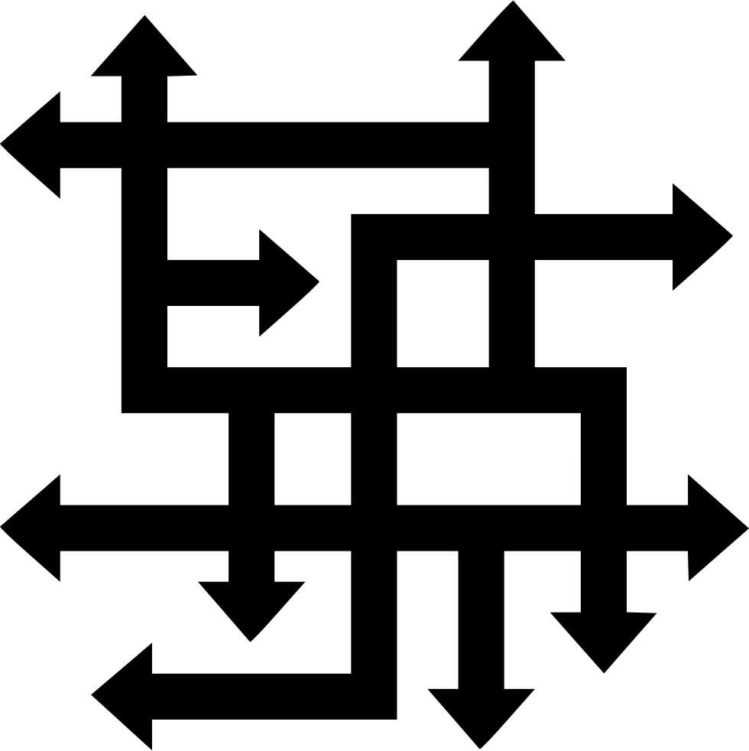
Bullying
Marriage
Drugs
Relationship
Stress
Honor
Unemployed
Depression
Isolation
Death of Love One
Family
Faith
Pain
Serial
Business
Financial
Medical
Legal
Psychological
Notes:
When the world around you feels like it is caving in, you have reached the point of complexity overload... Serial refers to suicides running in a family, military unit, etc...

Slide 3
Complexity Overload
Bullying
Marriage
Drugs
Relationship
Stress
Honor
Unemployed
Depression
Isolation
Death of Love One
Family
Faith
Pain
Serial
Business
Financial
Medical
Legal
Psychological
Notes:
When the world around you feels like it is caving in, you have reached the point of complexity overload... Serial refers to suicides running in a family, military unit, etc...

Slide 4
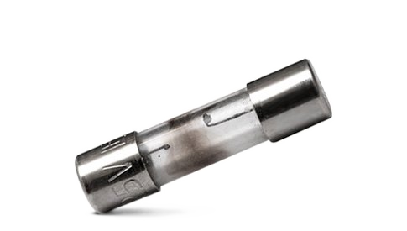
Complexity Overload
Bullying
Marriage
Drugs
Relationship
Stress
Honor
Unemployed
Depression
Isolation
Complexity Overload is when a person feels their life has become too complex for them to tolerate, and keeps getting more complex with each passing day.
Death of Love One
Family
Faith
Pain
Serial
Business
Financial
Medical
Legal
Psychological
Notes:
They see their life spinning out of control... Mental panic sets in... When complexity overload becomes to great to handle, a person blows their reality-fuse (way out fuse), that is to say, their ability to adapt, adjust, and affiliate (engage their family, friends, i.e., personal network ), all bets are off, and the outcome is seldom pretty...

Slide 5
Complexity Overload
Bullying
Marriage
Drugs
Relationship
Stress
Honor
Unemployed
They engage the means to reverse the complexity overload, or take an impulsive course of action...
Depression
Isolation
Death of Love One
Family
Faith
Pain
Serial
Business
Financial
Medical
Legal
Psychological
Notes:
In the struggle to fight on through the complexity overload, must people either self-intervene, or seek third-party intervention to change or reverse their situation. However, there are those individuals that are impulsive and may take drastic steps...

Slide 6
Complexity Overload
Bullying
Marriage
Drugs
Relationship
Stress
Honor
Unemployed
Select self-intervention means to stabilize and change their situation
Depression
Isolation
Death of Love One
Family
Faith
Pain
Serial
Business
Financial
Medical
Legal
Psychological
Notes:
They see themselves as the first step to change... Self-intervention is only assumed by the strongest willed people, they have the wherewithal to self-diagnosis, intervene, treat, and recover...

Slide 7
Complexity Overload
Bullying
Marriage
Drugs
Relationship
Stress
Honor
Unemployed
Depression
Isolation
Death of Love One
Family
Faith
Seek help in stabilizing and changing their situation
Pain
Serial
Business
Financial
Medical
Legal
Psychological
Notes:
Must people need outside help or assistance to overcome complexity overload, typically intervention starts with a phone call, a friend, or trust one... And can move on to one-on-one or group therapy, rehabilitation should drugs be part of the problem...

Slide 8
Complexity Overload
Bullying
Marriage
Drugs
Relationship
Stress
Honor
Unemployed
Depression
Isolation
Death of Love One
Family
Faith
Surrender to suicide as the only means to end their situation
Pain
Serial
Business
Financial
Medical
Legal
Psychological
Notes:
When isolated from family, friends, faith, feeling lonely, and their life is perceived as not worth living, going on is not an option, and death by suicide appears to be the quickest means to end their emotional and/or physical pain... Besides, they often believe no one cares if they live or die...

Slide 9
Complexity Overload
Stabilize
Synchronize
Salvage
Life is worth living in the end!
Notes:
Short circuit (stop) suicide ideation - Share optimistic opportunities so they can safely move to overcome complexity overload and return to caring reality (people do care about them), move them away from hopelessness to hope, help them move from darkness into the light of resolution, a new beginning, to see the light at the end of the tunnel (benefits) - Shape-Shift suicide ideation into living ideation, getting their life under control and realize a better and happier life awaits them... They are not alone on their journey to conquer complexity overload...

